Slide 1

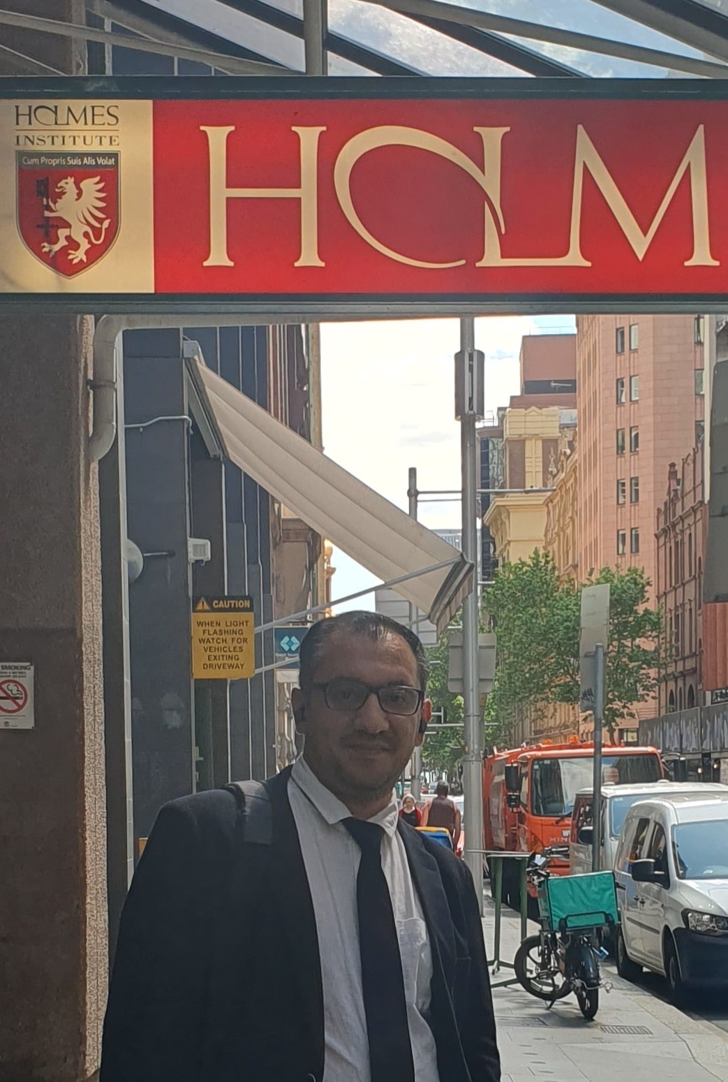
HI6040 (Artificial Intelligence and Machine Learning)
Dr. Farshid Keivanian
Tutorial Week 5

Slide 2
Step-by-Step Guideline for Group Class Facilitation
Step 1: Join a Group
Register on Blackboard before the deadline (28 Sept).
If you fail to join by then → you’ll be locked into a solo group with 20% penalty.
Do not join a group without permission from members — you may be removed.

Slide 3
Step-by-Step Guideline for Group Class Facilitation
Step 2: Understand the Requirements
Format: Group facilitation, class discussion
Weeks: 5–11.
Submission: Upload your slide to Blackboard before your facilitation session.
Presentation: 2 minutes summary + lead class discussion.

Slide 4
Step-by-Step Guideline for Group Class Facilitation
Step 3: Prepare Your Slide
Include:
Key points / guiding questions
Diagram, dataset, or code snippet (optional)
Real-world example
Keep it visual — avoid text-heavy slides.

Slide 5
Step-by-Step Guideline for Group Class Facilitation
Step 4: Facilitate the Class
Start with your question(s).
Get group members to discuss in pairs/small groups.
Bring back responses and summarise key insights.
Keep track of time — allow space for interaction.

Slide 6
Step-by-Step Guideline for Group Class Facilitation
Step 5: Submit Correctly
Upload with cover sheet (all contributing members). File must be PPT (not PDF).
If file >5MB or has video → upload to YouTube (public) + submit link + cover sheet.
X No screenshots/photos/handwritten notes.
X No email submissions.
X No late or overseas-IP uploads.

Slide 7
Step-by-Step Guideline for Group Class Facilitation
What to Avoid
Missing in-class presentation → zero mark.
Not being registered to a group in Blackboard → no marks awarded.
Listing non-contributors on cover sheet → misconduct.
Over-relying on ChatGPT/web sources (>10% content). Must link to unit syllabus.
Submitting in wrong format (PDF).

Slide 8
Step-by-Step Guideline for Group Class Facilitation
Hints & Preparation Examples
Practice as a group before class → anticipate possible answers.
Use practical examples: e.g., AI in banking fraud detection, hospital diagnosis, supply chain optimisation.
Keep open-ended questions, not yes/no.
Prepare one backup question if discussion runs short.

Slide 9
Step-by-Step Guideline for Group Class Facilitation
Do Students Need Python Code?
Coding is optional:
This facilitation is about leading discussion and showing understanding.
You may show small Python snippets (e.g., scikit-learn logistic regression) if it helps illustrate, but you will not be judged on code correctness.
Focus is on interpretation, discussion, and business context, not debugging or long coding.

Slide 10
Step-by-Step Guideline for Group Class Facilitation
Illustrative responses to give you ideas on how to prepare:
1. Problem Definition
Example (Healthcare AI triage):
Problem: Long wait times in emergency departments.
Significance: Delays can worsen patient outcomes and increase hospital costs.

Slide 11
Step-by-Step Guideline for Group Class Facilitation
2. AI Solution Overview
Example:
Proposed Solution: Supervised learning → Logistic Regression on patient history + symptoms.
Business Justification: Faster triage → improved patient flow, reduced costs, better care.

Slide 12
Step-by-Step Guideline for Group Class Facilitation
3. Benefits and Opportunities
Example:
Faster triage (measured by reduced waiting times).
Higher accuracy in identifying critical patients.
Cost savings through better resource allocation.

Slide 13
Step-by-Step Guideline for Group Class Facilitation
4. Risks & Ethical Considerations
Example:
Risk: Biased training data → unfair prioritisation.
Risk: Technical error → misdiagnosis.
Risk: Privacy issues in storing patient history.
Mitigations: Diverse training data, backup human oversight, HIPAA-compliant data storage.

Slide 14
Step-by-Step Guideline for Group Class Facilitation
5. Implementation Steps
Example:
Collect and clean hospital dataset.
Train baseline Logistic Regression model.
Validate with doctors → feedback loop.
Pilot test in one department.
Scale across hospital with monitoring.

Slide 15
Step-by-Step Guideline for Group Class Facilitation
Final Checklist for Students
Joined a group (before deadline).
Selected topic + case study sector.
Prepared 1 PPT slide (key points, examples, questions).
Practised 2-minute summary.
Ensured submission is in Blackboard (PPT only, with cover sheet).
Ready to facilitate discussion, not lecture.

Slide 16
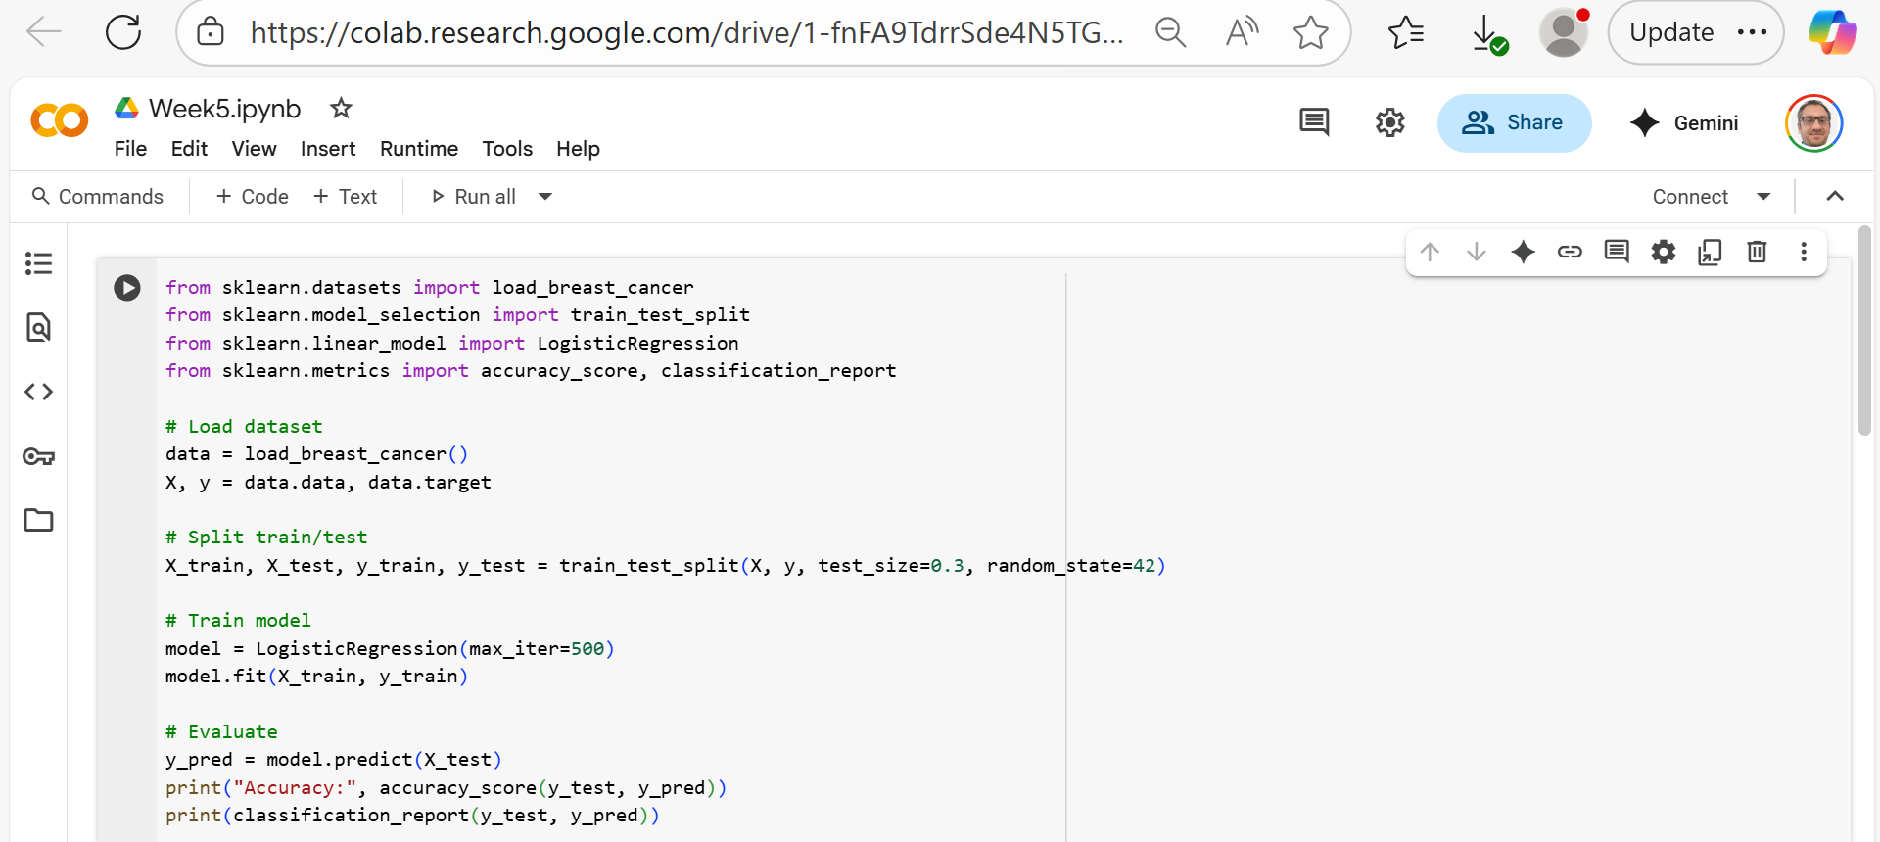

Supervised Learning Example
1. Logistic Regression on a Simple Dataset
This ties directly to supervised learning basics (classification).
Learning outcome: Students see how a simple logistic regression works for binary classification.

Slide 17
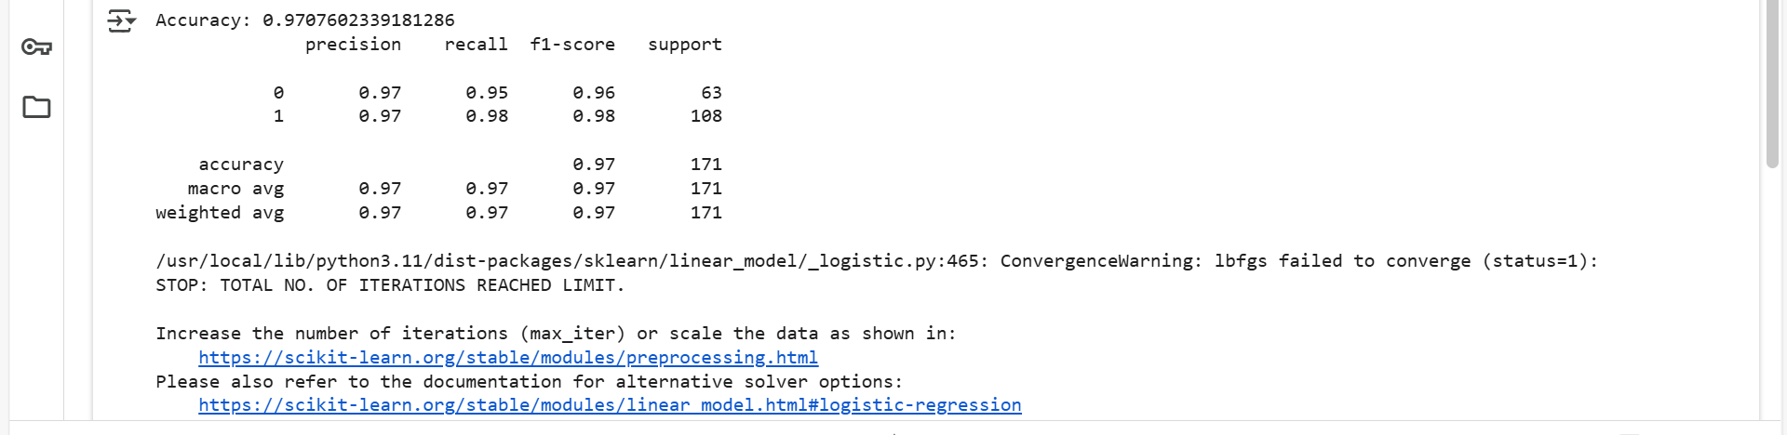
Supervised Learning Example
Result Analysis:

Slide 18
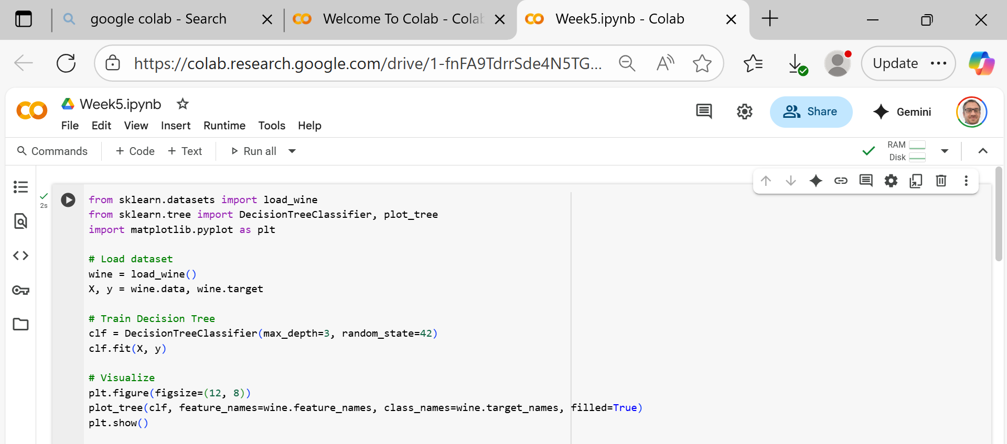
Supervised Learning Example
2. Decision Tree Classifier with Visualisation
Easy to interpret and useful for in-class discussions.
Learning outcome: Students see how trees split features, and why max_depth matters.

Slide 19
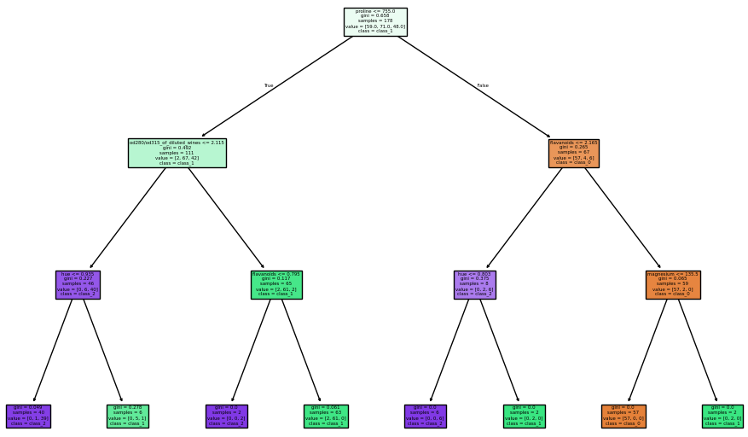
Supervised Learning Example
Result Analysis:

Slide 20
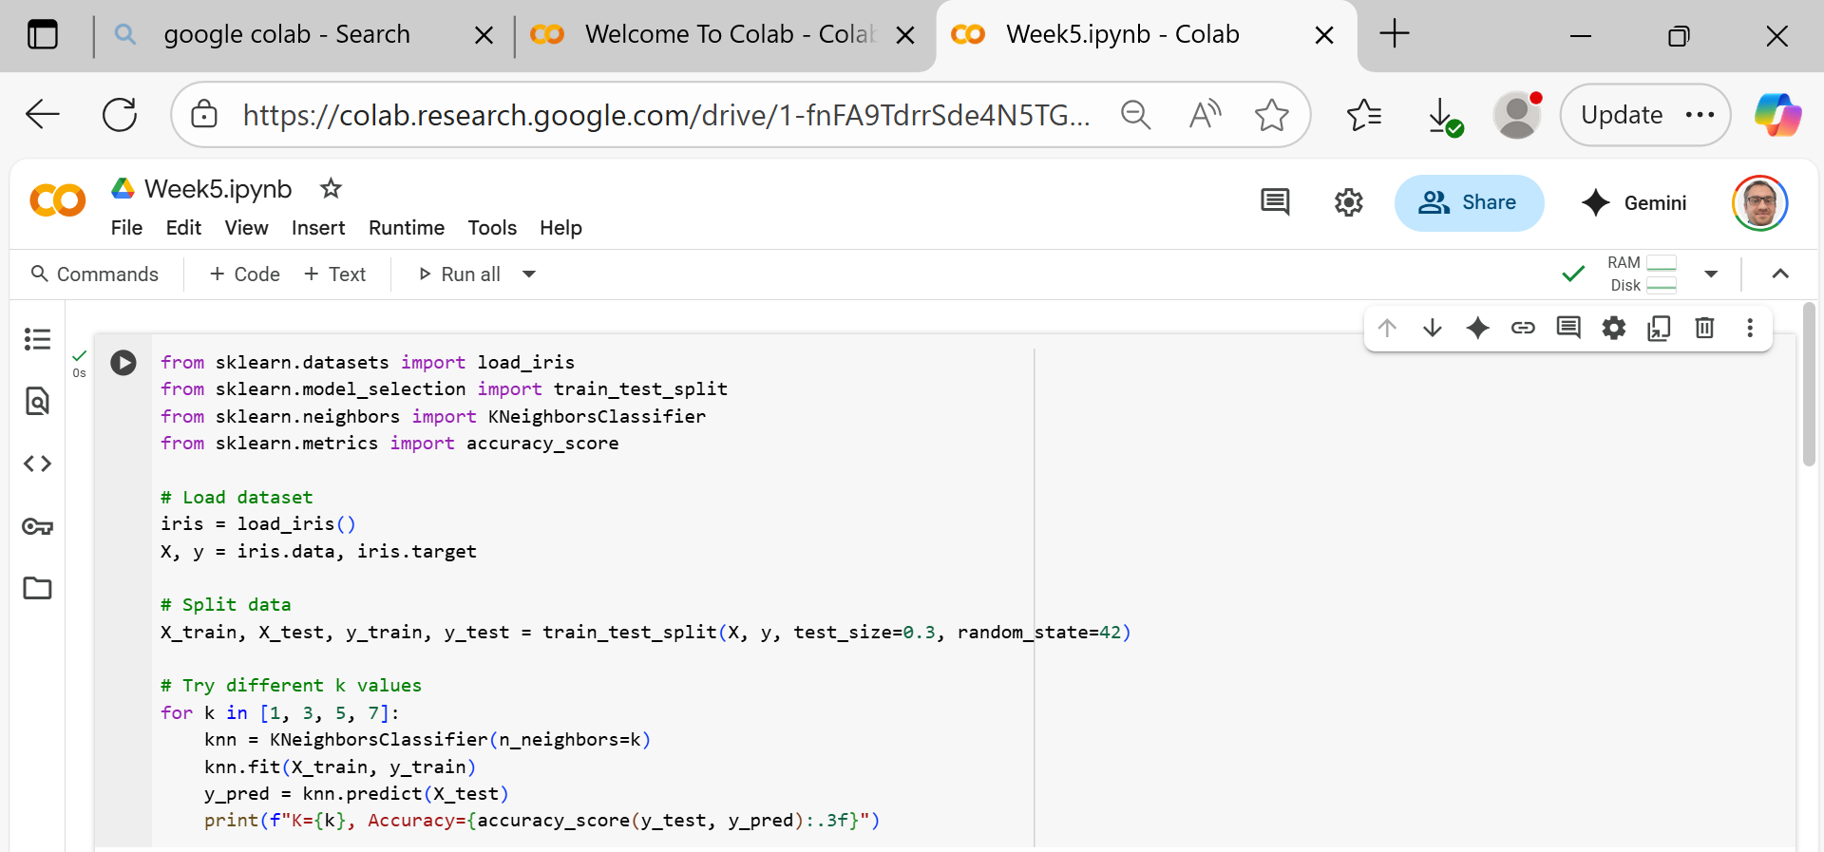
Supervised Learning Example
3. K-Nearest Neighbors (KNN) Classifier
Good to demonstrate the effect of hyperparameters (k).
Learning outcome: Students see how changing k affects bias vs variance.

Slide 21
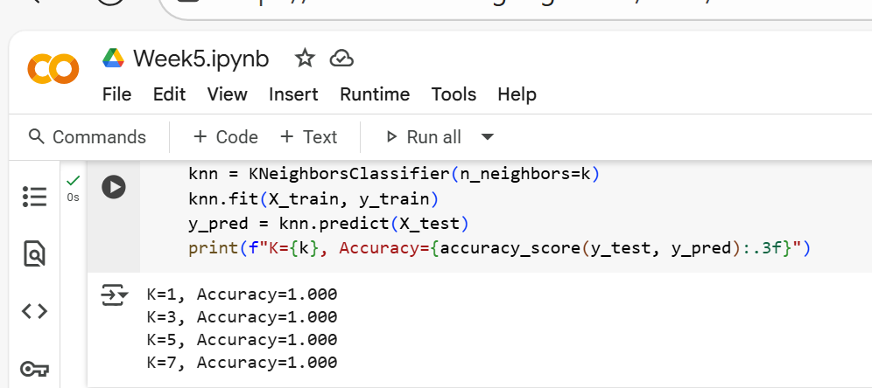
Supervised Learning Example
Result Analysis

Slide 22
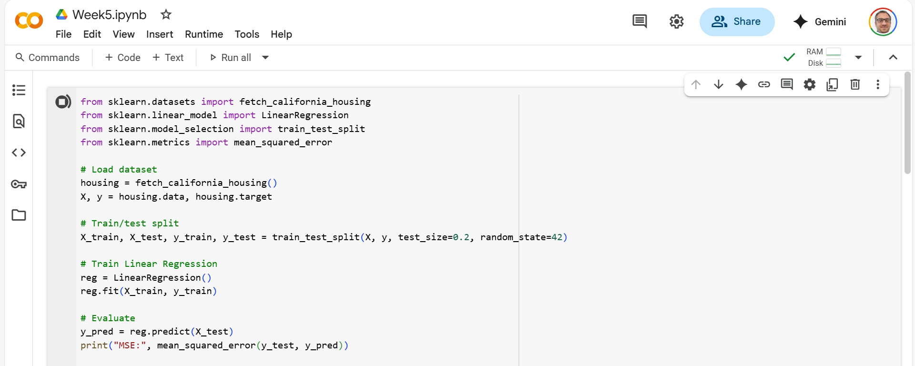
Supervised Learning Example
4. Regression Example (Boston Housing or Synthetic Data)
To contrast with classification.
Learning outcome: Students understand regression vs classification outputs.

Slide 23
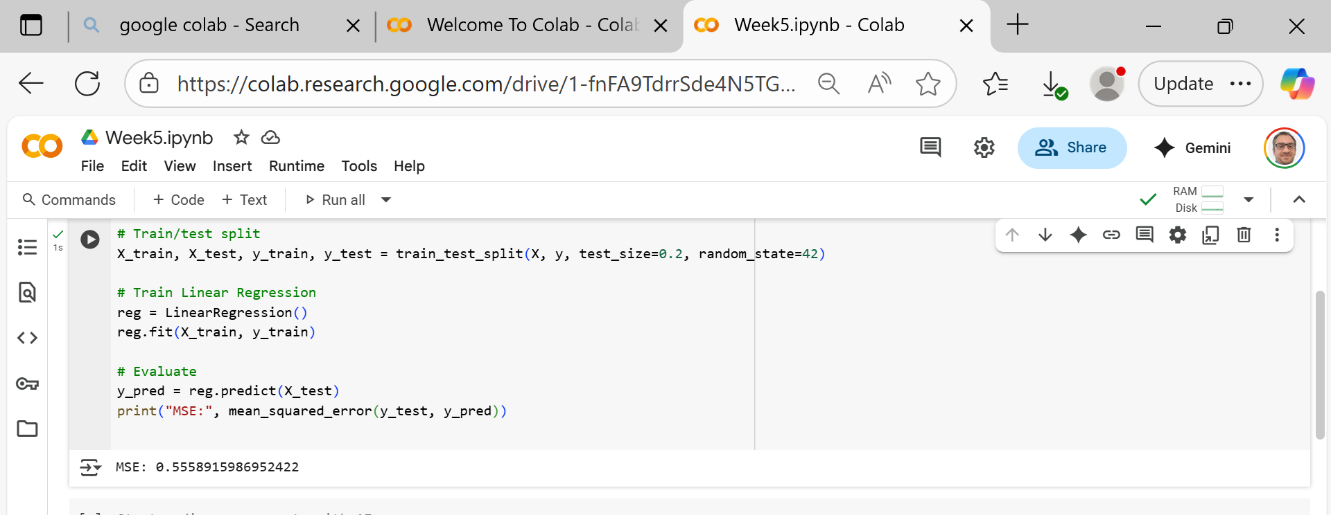
Supervised Learning Example
Result Analysis

Slide 24
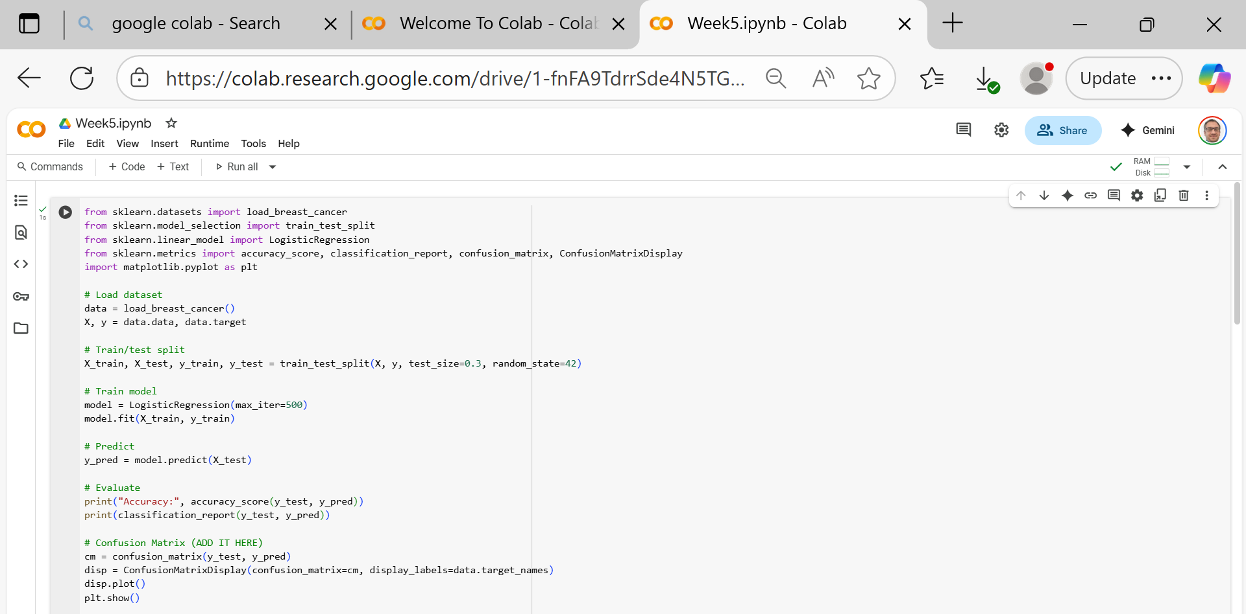
Supervised Learning Example
5. Logistic Regression with Confusion Matrix
This builds skills for Week 6 (evaluation).

Slide 25
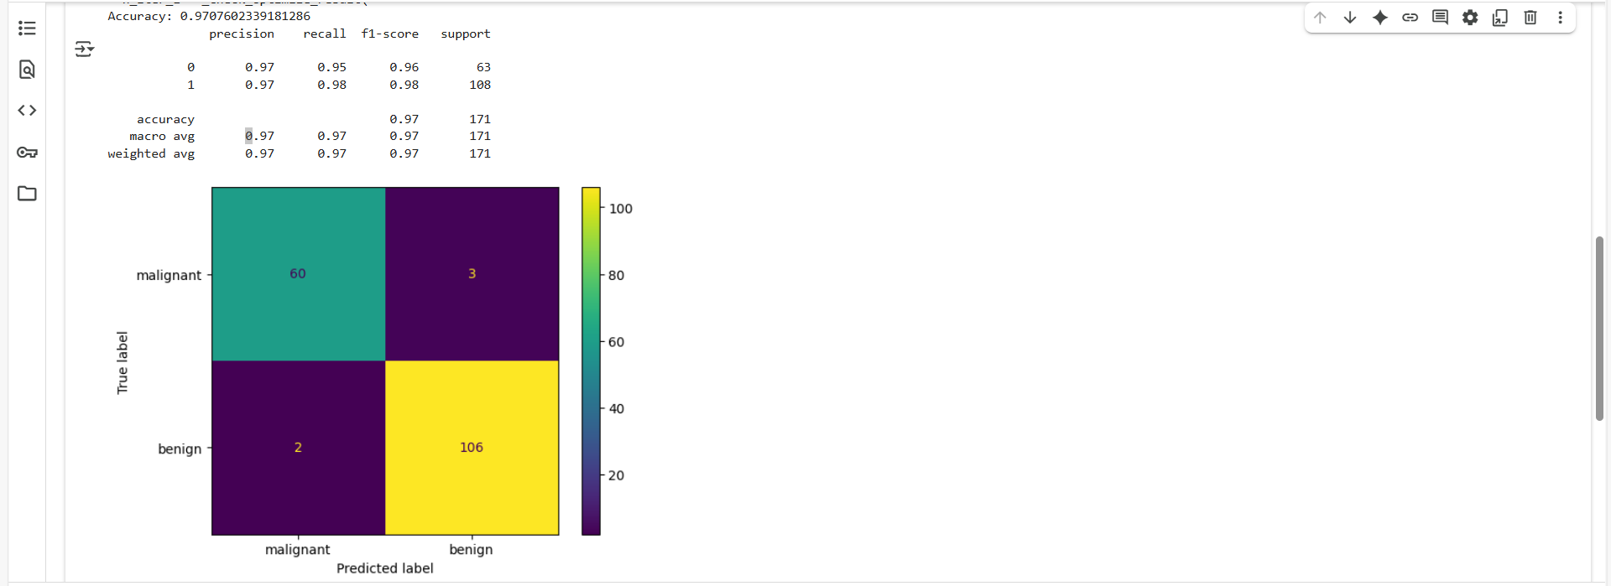
Supervised Learning Example
Result Analysis

Slide 26
Summary for Week 5 practice
Logistic Regression → core classification
Decision Trees → interpretable ML
KNN → hyperparameters and bias/variance
Linear Regression → regression vs classification
Confusion Matrix → evaluation skills

Slide 27
Thank You
Need Help with coding? Send an email or ask during the tutorial session.
FKeivanian@my.holmes.edu.au

